Slide 1

J.P. Morgan European Automotive Conference 2026
Saving More Lives
June 1, 2026

Slide 2
Safe Harbor Statement*
This report contains statements that are not historical facts but rather forward-looking statements within the meaning of the Private Securities Litigation Reform Act of 1995. Such forward-looking statements include those that address activities, events or developments that Autoliv, Inc. or its management believes or anticipates may occur in the future. All forward-looking statements are based upon our current expectations, various assumptions and/or data available from third parties. Our expectations and assumptions are expressed in good faith and we believe there is a reasonable basis for them. However, there can be no assurance that such forward-looking statements will materialize or prove to be correct as forward-looking statements are inherently subject to known and unknown risks, uncertainties and other factors which may cause actual future results, performance or achievements to differ materially from the future results, performance or achievements expressed in or implied by such forward-looking statements. In some cases, you can identify these statements by forward-looking words such as “estimates”, “expects”, “anticipates”, “projects”, “plans”, “intends”, “believes”, “may”, “likely”, “might”, “would”, “should”, “could”, or the negative of these terms and other comparable terminology, although not all forward-looking statements contain such words. Because these forward-looking statements involve risks and uncertainties, the outcome could differ materially from those set out in the forward-looking statements for a variety of reasons, including without limitation: general global and regional economic conditions, including the impact of inflation; changes in light vehicle production; fluctuation in vehicle production schedules for which the Company is a supplier; global supply chain disruptions, including port, transportation, and distribution delays or interruptions; supply chain disruptions, and component shortages specific to the automotive industry or the Company; potential changes to beneficial free trade agreements and regulations, such as the United States-Mexico-Canada Agreement; changes in geopolitical and other economic and political conditions or developments, including inflation, changes trade policies, tariff regimes, and other developments in and by countries in which we do business that could materially impact supply chains, margins, access to capital, or overall business performance; political stability or geopolitical conflicts; changes in general industry or market conditions, including regional economic growth or decline; changes in and the successful execution of our capacity alignment, restructuring, cost reduction, and efficiency initiatives and the market reaction thereto; loss of business from increased competition; volatility or increases in raw material, fuel, and energy costs; changes in consumer and customer preferences for end products; loss of customers or sales; legislative or regulatory changes; customer bankruptcies, consolidations or restructuring or divestiture of customer brands; unfavorable fluctuations in currencies or interest rates among the various jurisdictions in which we operate; market acceptance of our new products; costs or difficulties related to the integration of any new or acquired businesses and technologies; continued uncertainty in pricing and other negotiations with customers, including inflation and tariff compensations; successful integration of acquisitions and operations of joint ventures; successful implementation of strategic partnerships and collaborations; our ability to be awarded new business; product liability, warranty and recall claims and investigations and other litigation, civil judgments or financial penalties and customer reactions thereto; higher expenses for our pension and other postretirement benefits, including higher funding needs for our pension plans; work stoppages or other labor issues; possible adverse results of pending or future litigation or infringement claims, and the availability of insurance with respect to such matters; our ability to protect our intellectual property rights; negative impacts of antitrust investigations or other governmental investigations and associated litigation relating to the conduct of our business; tax assessments or results of tax audits by governmental authorities and changes in our effective tax rate; dependence on key personnel; our ability to meet our sustainability targets, goals and commitments; dependence on and relationships with customers and suppliers; the conditions necessary to hit our financial targets; and other risks and uncertainties identified under the headings “Risk Factors” and “Management’s Discussion and Analysis of Financial Condition and Results of Operations” in our Annual Reports and Quarterly Reports on Forms 10-K and 10-Q and any amendments thereto. For any forward-looking statements contained in this or any other document, we claim the protection of the safe harbor for forward-looking statements contained in the Private Securities Litigation Reform Act of 1995, and we assume no obligation to update publicly or revise any forward-looking statements in light of new information or future events, except as required by law.
* Non-US GAAP reconciliations are disclosed in our regulatory filings available at www.sec.gov or www.autoliv.com
This presentation Includes content supplied by S&P Global; Copyright © Light Vehicle Production Forecast April 2026. All rights reserved.
S&P Global is a global supplier of independent industry information. The permission to use S&P Global copyrighted reports, data and information does not constitute an endorsement or approval by S&P Global of the manner, format, context, content, conclusion, opinion or viewpoint in which S&P Global reports, data and information or its derivations are used or referenced herein.
Notes:
22 May 2026

Slide 3

Strategic Strengths

Slide 4

Market leadership in all regions and across product segments
Seatbelt
market share
EUROPE
52%
CHINA
33%
EUROPE
28%
CHINA
19%
AMERICAS
47%
Airbag &
steering wheel
market share
AMERICAS
33%
ASIA
44%
ASIA
19%
2024 MARKET
SHARE*
2024
SHARE
OF TOTAL SALES
^{(*)}Company estimates

Slide 5
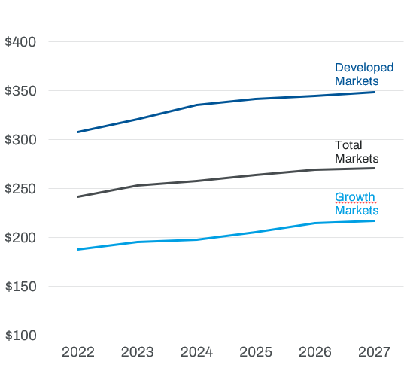
Safety Content per Vehicle is increasing across all regions, although the growth rates varies
(from CMD June, 2025)
Safety Content per Vehicle (CPV)
‘22-’27 CAGR
+2.5%
+2.3%
+2.9%

Slide 6
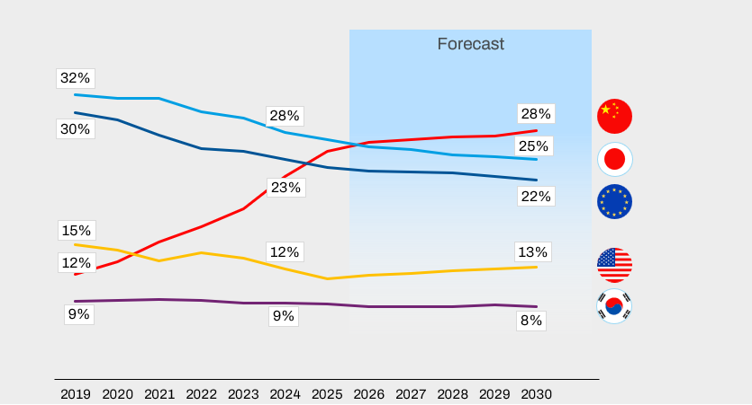
The past years the Light Vehicle market experienced a shift in OEM mix
(from CMD June, 2025)
OEM market share development – Global
  Chinese OEMs are expanding their market shares both domestically and internationally
Source: S&P Global May 2025, Jaguar Land Rover, Volvo are considered E-OEMs. NA brands of Stellantis are considered to be NA-OEMs

Slide 7
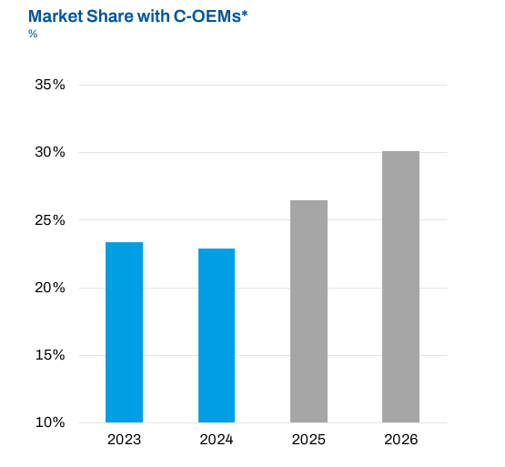

Autoliv China – Serving 42 C-OEM and 27 G-OEM Customers (@ 2 June, 2025)
(from CMD June, 2025)
Xpeng G9
(*) Company estimates

Slide 8

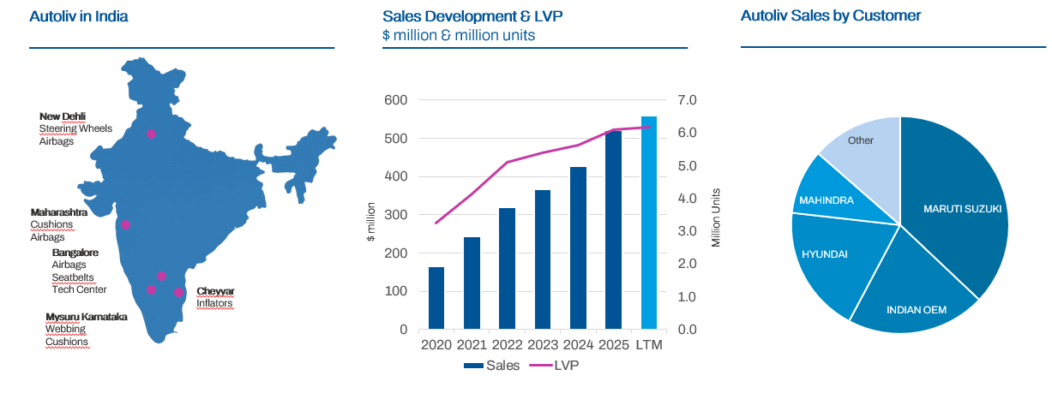
India: A Key Driver of Autoliv’s Growth

Slide 9
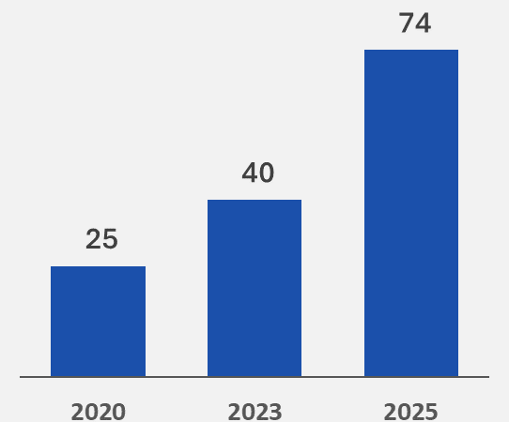
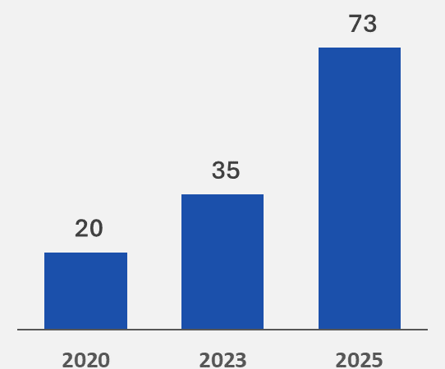
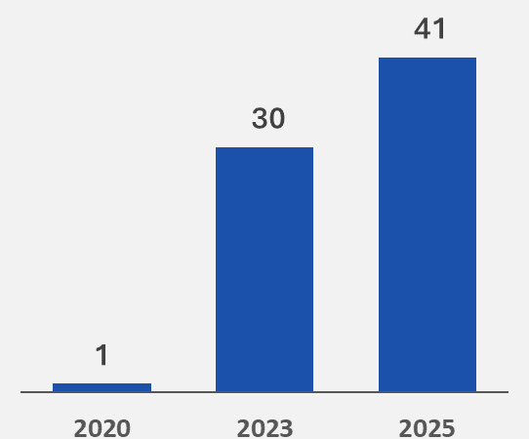
Automation is a Top Priority – Increasing Level with New Line Launches
(from CMD June, 2025)
The ratio of automation levels in new equipment has increased significantly
Airbags
% of new lines installed
Seatbelts
% of new lines installed
Steering Wheels
% of new lines installed

Slide 10
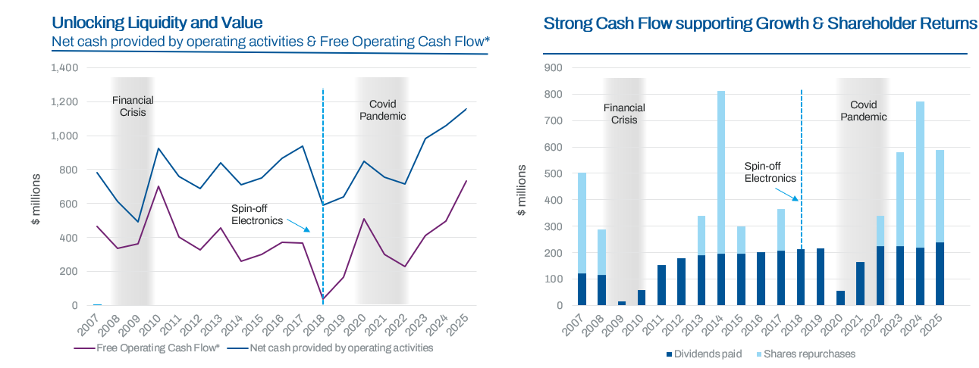
Resilient Track Record of Cash Flow and Returns
* Non-US GAAP measures

Slide 11

Q1 2026

Slide 12
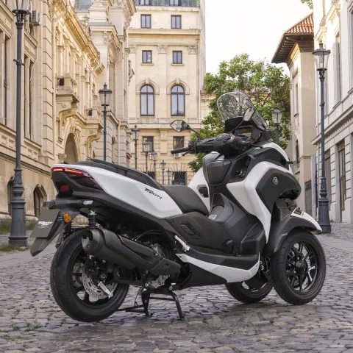

Q1’26 Key Highlights – Record First Quarter Sales Supported by Growth in Asia and Positive Currency Effects
Strong Quarterly Sales – Driven by Strong Growth in India and China as well as positive currency effects
  Sales exceeded expectations in most regions, led by a particularly strong March
  India was the largest contributor to growth
  Sales to Chinese OEMs increased by almost 30% – driven by recent launches
Underlying profitability improved, reflected in stronger gross profit relative to sales, while the adjusted operating income* declined slightly Y-o-Y
  The adjusted operating margin* development negatively affected by lower customer RD&E reimbursements and the divestiture of assets in Russia in Q1´25
Cash flow was temporarily impacted by working capital effects, primarily driven by strong March sales and other short‑term factors
We paid a dividend of $0.87 per share, representing a total payout of $65 million
Limited impact from the hostilities around the Persian Gulf this quarter. We are monitoring any potential wide-reaching impact on the industry
FY 2026 Adjusted operating margin* guidance unchanged
Introduced the first commercially ready airbag for motorcycles
Autoliv has taken a significant step forward in motorcycle rider protection, reinforcing its vision of Saving More Lives by launching the first airbag specifically developed for commuter scooters, alongside a comprehensive on‑rider wearable inflatable protection system.
* Non-US GAAP excluding effects from capacity alignment and antitrust related matters
** Light Vehicle Production (LVP up to 3.5 tons) according to S&P Global @ April 2026
Notes:
22 May 2026

Slide 13
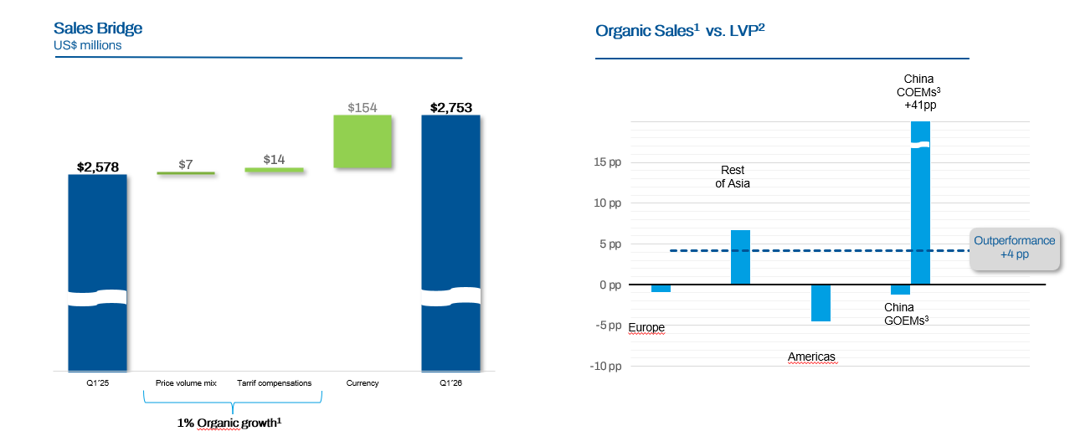
Q1’26 Sales Growth and Regional Sales Split
Non-US GAAP measure
Light Vehicle Production (LVP up to 3.5 tons) according to S&P Global @ April 2026.
COEMs: Chinese OEMs excluding Volvo and Polestar ; GOEMs: other vehicle manufacturers operating in China

Slide 14
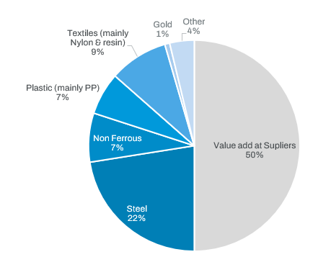
Raw Materials: Resilient Cost Structure with Pricing and Indexation Support
Direct Material Purchase Split 2025
~54% of sales
Primarily purchasing components rather than raw materials
The hostilities in and around the Persian Gulf impact Textiles and Plastic – but also Aluminum, Helium and Steel
Plastic and Chemicals prices largely correlates with oil prices over time
Supplier pricing typically reflects a 3 to 6-month lag versus spot prices
Mitigations
  Productivity and cost reduction initiatives
  Customer compensation mechanisms are expected to offset a meaningful portion, though with a timing delay
  Approximately 50% of raw material exposure is indexed
2026 guidance assumes ~$90m gross raw material impact, with most headwinds expected to be mitigated through commercial actions and internal cost reduction initiatives

Slide 15
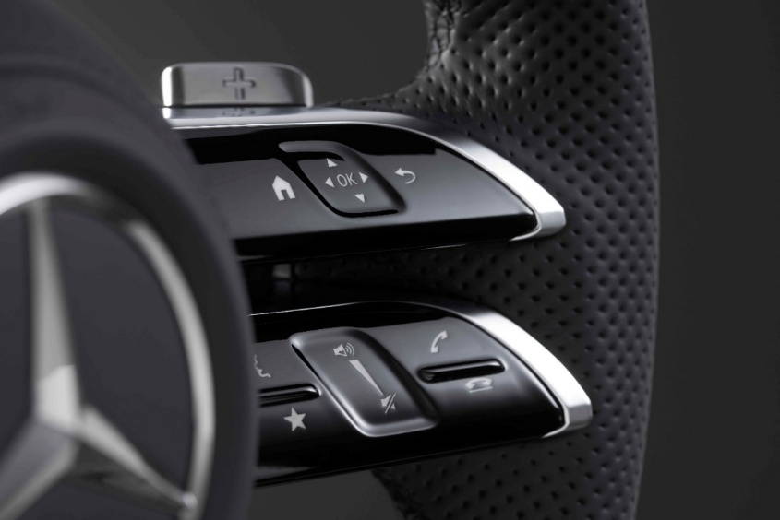
Updated Full Year 2026 Guidance¹ & Assumptions as expressed on April 17, 2026
 | Full Year 2026 Guidance
Organic sales increase² | Around 0 | Previously ~0%
Adjusted Operating margin² | Around 10.5 to 11% | unchanged
Operating Cash flow³ | Around $1.2 billion | unchanged
Capex, net % of sales | Less than 5% | unchanged
 | Assumptions
LVP Growth | Around 1% negative | unchanged
FX | Around 3% positive | Previously 1%
Tax rate⁴ | Around 28% | unchanged
Exchange Rates
US$/EUR | 0.8472
US$/JPY | 155.91
US$/KRW | 1440.5
US$/MXN | 17.198
US$/CNY | 6.8571
⁽¹⁾ Our full year 2026 guidance is based on our customer call-offs, as well as the achievement of our targeted cost compensation adjustments with our customers including for the new tariffs, no further material changes to tariffs or trade restrictions that are in effect as of April 10, 2026 , as well as no significant changes in the macro-economic environment, changes in customer call-off volatility or significant supply chain disruptions.
⁽²⁾ Non-US GAAP excluding effects from capacity alignment and antitrust related matters ⁽³⁾ Excluding unusual items ⁽⁴⁾ Excluding unusual tax items

Slide 16
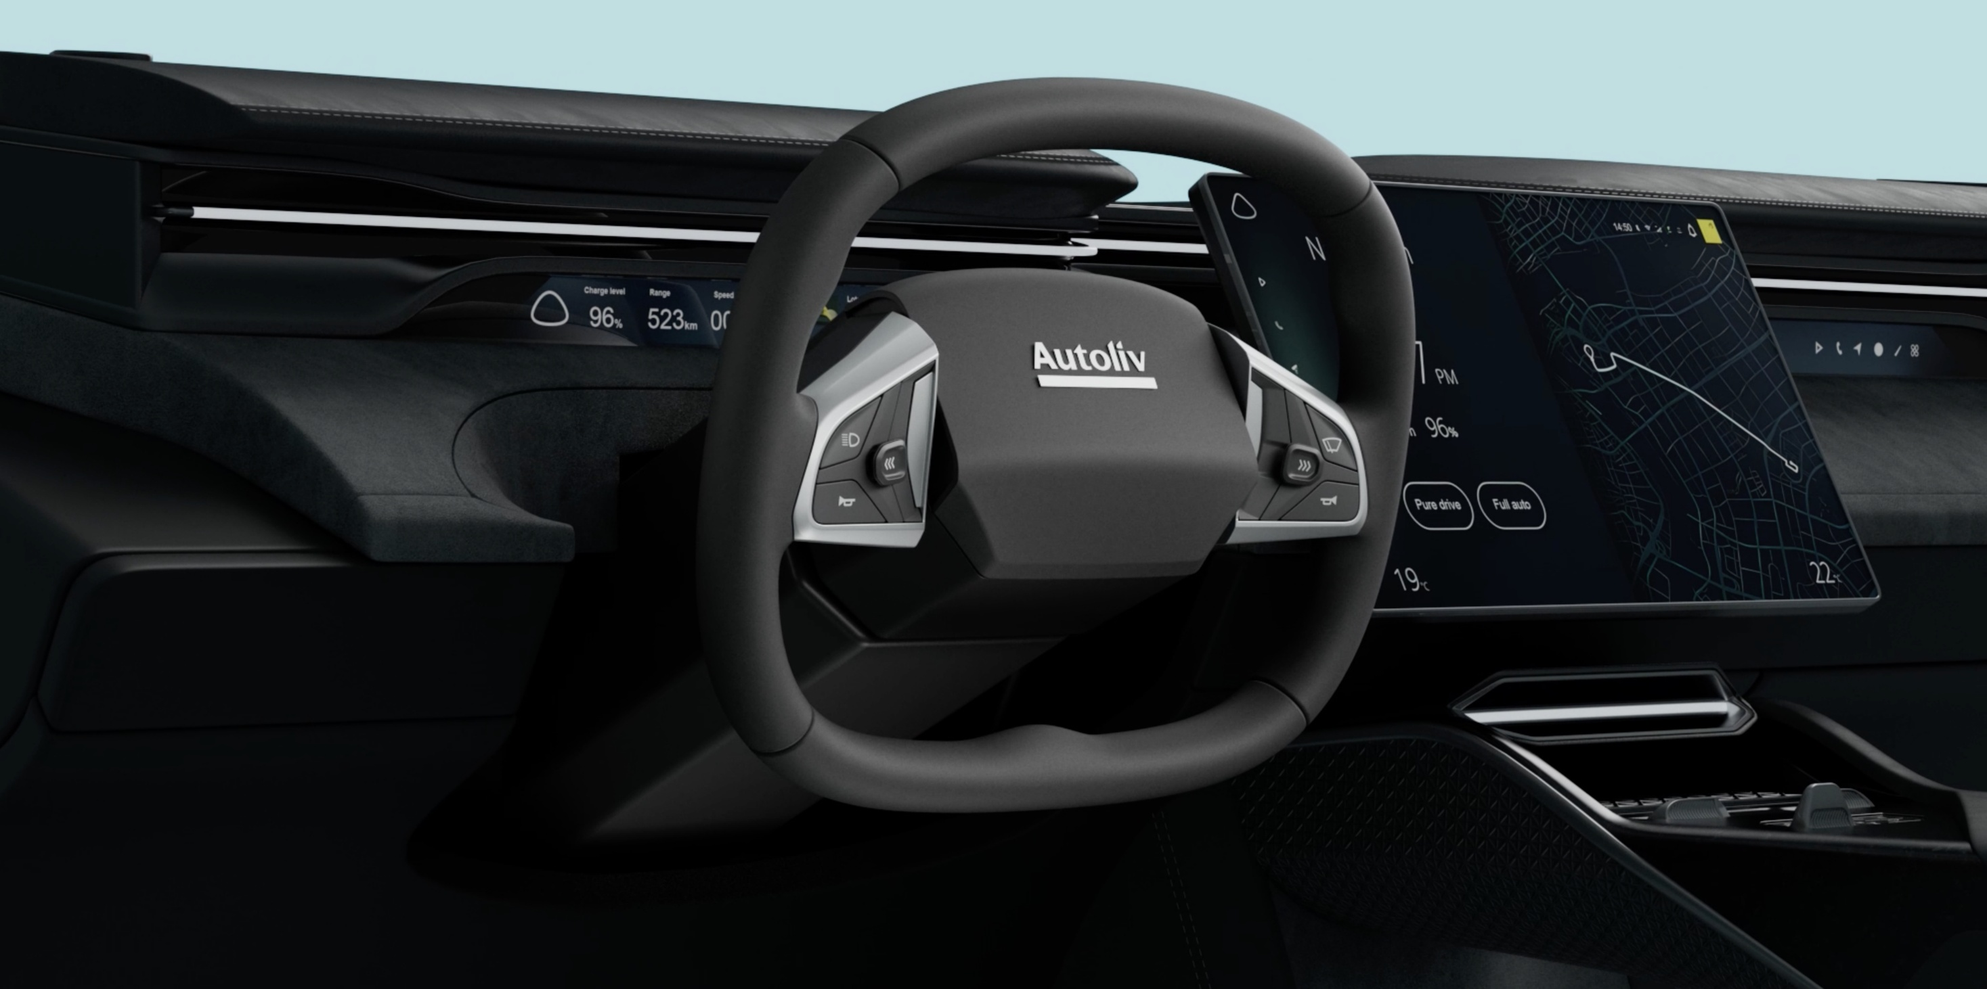
Appendix

Slide 17
Reconciliation of GAAP measure "Operating margin" to Non-GAAP measure "Adjusted Operating margin"
We believe that comparability between periods is improved through the exclusion of certain items. To assist investors in understanding the operating performance of Autoliv's business, it is useful to consider certain U.S. GAAP measures exclusive of these items.
With respect to the Andrews litigation settlement, the Company has treated this specific settlement as a non-recurring charge because of the unique nature of the lawsuit, including the facts and legal issues involved.
Accordingly, the table below reconcile from U.S. GAAP to the equivalent non-U.S. GAAP measure.
 | 2026 | 2025 |  |  |  | 2024 |  |  |  | 2023
 | Q1 | Q4 | Q3 | Q2 | Q1 | Q4 | Q3 | Q2 | Q1 | Q4 | Q3 | Q2 | Q1
Operating margin (GAAP) | 8.6% | 11.3% | 9.9% | 9.1% | 9.9% | 13.5% | 8.9% | 7.9% | 7.4% | 8.6% | 8.9% | 3.6% | 5.1%
Non-GAAP adjustments:
Less: Capacity alignments | 0.3% | 0.6% | 0.1% | 0.0% | 0.1% | -0.2% | 0.4% | 0.5% | 0.1% | 3.5% | 0.4% | 4.1% | 0.1%
Less: The Andrews litigation settlement | - | - | - | - | - | - | - | - | - | - | - | 0.3% | -
Less: Antitrust related items | 0.0% | 0.0% | 0.1% | 0.1% | 0.0% | 0.1% | 0.1% | 0.0% | 0.1% | 0.0% | 0.0% | 0.0% | 0.0%
Total non-GAAP adjustments to operating margin | 0.3% | 0.6% | 0.1% | 0.1% | 0.0% | -0.2% | 0.4% | 0.6% | 0.2% | 3.5% | 0.4% | 4.5% | 0.2%
Adjusted Operating margin (Non-GAAP) | 8.9% | 12.0% | 10.0% | 9.3% | 9.9% | 13.4% | 9.3% | 8.5% | 7.6% | 12.1% | 9.4% | 8.0% | 5.3%

Slide 18
Reconciliation of Non-US GAAP measure “Leverage ratio & Adjusted EBITDA"
The non-U.S. GAAP measure “net debt” is also used in the non-U.S. GAAP measure “Leverage ratio”. Management uses this measure to analyze the amount of debt the Company can incur under its debt policy. Management believes that this policy also provides guidance to credit and equity investors regarding the extent to which the Company would be prepared to leverage its operations. Autoliv’s policy is to maintain a leverage ratio commensurate with a strong investment grade credit rating. The Company measures its leverage ratio as net debt* adjusted for pension liabilities in relation to adjusted EBITDA*. The long-term target is to maintain a leverage ratio equal to or below 1.5x.
(Dollars in millions) | 2026 | 2025 |  |  |  | 2024 |  |  |  | 2023
 | Mar 31 | Dec 31 | Sep 30 | Jun 30 | Mar 31 | Dec 31 | Sep 30 | Jun 30 | Mar 31 | Dec 31 | Sep 30 | Jun 30 | Mar 31
Net debt¹⁾ | $1,774 | $1,566 | $1,772 | $1,752 | $1,787 | $1,554 | $1,787 | $1,579 | $1,562 | $1,367 | $1,375 | $1,299 | $1,477
Pension liabilities | 176 | 169 | 167 | 167 | 163 | 153 | 147 | 140 | 149 | 159 | 152 | 152 | 159
Net debt per the Policy | $1,950 | $1,736 | $1,939 | $1,919 | $1,950 | $1,708 | $1,934 | $1,720 | $1,711 | $1,527 | $1,527 | $1,451 | $1,636
Net income²⁾ | $710 | $736 | $754 | $717 | $688 | $648 | $632 | $627 | $541 | $489 | $418 | $390 | $416
Income taxes²⁾ | 246 | 253 | 261 | 255 | 246 | 227 | 141 | 150 | 136 | 123 | 188 | 168 | 176
Interest expense, net^{2, 3)} | 93 | 93 | 94 | 96 | 97 | 95 | 93 | 89 | 83 | 80 | 75 | 67 | 60
Other non-operating items, net²⁾ | 28 | 15 | 20 | 19 | 16 | 16 | 4 | 8 | 1 | 3 | 5 | 1 | 4
Income from equity method investments²⁾ | (6) | (6) | (6) | (6) | (6) | (7) | (6) | (6) | (5) | (5) | (4) | (4) | (4)
Depreciation and amortization of intangibles²⁾ | 419 | 407 | 397 | 390 | 386 | 387 | 385 | 384 | 381 | 378 | 371 | 363 | 359
Less: Capacity alignments²⁾ | 28 | 23 | (1) | 6 | 19 | 19 | 121 | 122 | 217 | 218 | 125 | 117 | 8
Less: Antitrust related items²⁾ | 4 | 3 | 5 | 6 | 4 | 8 | 7 | 6 | 6 | 4 | 3 | 2 | 1
Less: Other Items²⁾ | - | - | - | - | (0) | 0 | 0 | (0) | 8 | 8 | 8 | 8 | -
EBITDA per the Policy (Adjusted EBITDA) | $1,523 | $1,521 | $1,524 | $1,483 | $1,449 | $1,394 | $1,376 | $1,380 | $1,369 | $1,297 | $1,189 | $1,112 | $1,021
Leverage ratio | 1.3 | 1.1 | 1.3 | 1.3 | 1.3 | 1.2 | 1.4 | 1.2 | 1.3 | 1.2 | 1.3 | 1.3 | 1.6
1) Short- and long-term debt less cash and cash equivalents and debt-related derivatives. See Items Affecting Comparability below 2) Latest 12 months. 3) Interest expense including cost for extinguishment of debt, if any, less interest income.

Slide 19
Reconciliation of Non-US GAAP measure “Net Debt"
(Dollars in millions) | 2026 | 2025 |  |  |  | 2024 |  |  |  | 2023
 | Mar 31 | Dec 31 | Sep 30 | Jun 30 | Mar 31 | Dec 31 | Sep 30 | Jun 30 | Mar 31 | Dec 31 | Sep 30 | Jun 30 | Mar 31
Short-term debt | $393 | $419 | $654 | $679 | $540 | $387 | $624 | $455 | $310 | $538 | $590 | $481 | $577
Long-term debt | 1,699 | 1,734 | 1,374 | 1,372 | 1,565 | 1,522 | 1,586 | 1,540 | 1,830 | 1,324 | 1,277 | 1,290 | 1,601
Total debt | 2,091 | 2,153 | 2,027 | 2,051 | 2,105 | 1,909 | 2,210 | 1,996 | 2,140 | 1,862 | 1,867 | 1,771 | 2,179
Cash & cash equivalents | (342) | (604) | (225) | (237) | (322) | (330) | (415) | (408) | (569) | (498) | (475) | (475) | (713)
Debt issuance cost/Debt-related derivatives, net | 24 | 17 | (30) | (62) | 4 | (24) | (9) | (8) | (9) | 3 | (17) | 4 | 12
Net debt | $1,774 | $1,566 | $1,772 | $1,752 | $1,787 | $1,554 | $1,787 | $1,579 | $1,562 | $1,367 | $1,375 | $1,299 | $1,477

Slide 20
Reconciliation of GAAP measure "Earnings per share - diluted" to Non-GAAP measure "Adjusted Earnings per share - diluted"
(Dollars in millions) | 2026 | 2025
 | First Quarter
Earnings per share - diluted (GAAP) | $1.88 | $2.14
Non-GAAP adjustments: | 0.10 | 0.02
Less: Capacity alignments | 0.12 | -
Less: Antitrust related items | 0.00 | (0.02)
Less: Tax on non-GAAP adjustments | (0.05) | (0.00)
Total non-GAAP adjustments to Earnings per share - diluted | 0.17 | 0.01
Adjusted Earnings per share - diluted (Non-GAAP) | $2.05 | $2.15
Weighted average number of shares outstanding – diluted (million) | 75.1 | 77.9

Slide 21
Reconciliation of Non-US GAAP measure "Trade Working Capital"
Due to the need to optimize cash generation to create value for shareholders, management focuses on operationally derived trade working capital as defined in the table below. Trade working capital is an indicator of operational efficiency, which impacts the Company’s ability to return value to shareholders either through dividends or share repurchases. We believe this is useful for readers to understand the efficiency of the Company’ operational capital management. The reconciling items used to derive this measure are, by contrast, managed as part of our overall management of cash and debt, but they are not part of the responsibilities of day-to-day operations management.
(Dollars in millions) | 2026 | 2025 |  |  |  | 2024 |  |  |  | 2023
 | 31-mar | 31-dec | 30-sep | 30-jun | 31-mar | 31-dec | 30-sep | 30-jun | 31-mar | 31-dec | 30-sep | 30-jun | 31-mar
Receivables, net | $2,422 | $2,236 | $2,357 | $2,341 | $2,205 | $1,993 | $2,192 | $2,090 | $2,194 | $2,198 | $2,179 | $2,189 | $2,106
Inventories, net | 947 | 992 | 1,036 | 957 | 913 | 921 | 997 | 936 | 997 | 1,012 | 982 | 947 | 986
Accounts payable | (1,862) | (2,007) | (1,889) | (1,945) | (1,839) | (1,799) | (1,881) | (1,858) | (1,855) | (1,978) | (1,858) | (1,844) | (1,683)
Trade working capital (non-U.S. GAAP) | $1,506 | $1,221 | $1,504 | $1,354 | $1,279 | $1,115 | $1,307 | $1,169 | $1,336 | $1,232 | $1,303 | $1,292 | $1,409
Quarterly sales | $2,753 | $2,817 | $2,706 | $2,714 | $2,578 | $2,616 | $2,555 | $2,605 | $2,615 | $2,751 | $2,596 | $2,635 | $2,493
Annualized quarterly sales¹⁾ | 11,012 | 11,269 | 10,822 | 10,857 | 10,312 | 10,463 | 10,218 | 10,420 | 10,459 | 11,006 | 10,386 | 10,539 | 9,970
Trade working capital in relation to annualized quarterly sales | 13.7% | 10.8% | 13.9% | 12.5% | 12.4% | 10.7% | 12.8% | 11.2% | 12.8% | 11.2% | 12.5% | 12.3% | 14.1%
(Dollars in millions) | 2022 |  |  |  | 2021 |  |  |  | 2020 |  |  |  | 2019
 | 31- dec | 30-sep | 30-jun | 31-mar | 31-dec | 30-sep | 30-jun | 31-mar | 31-dec | 30-sep | 30-jun | 31-mar | 31-dec
Receivables, net | $1,907 | $1,893 | $1,779 | $1,824 | $1,699 | $1,575 | $1,719 | $1,846 | $1,822 | $1,616 | $1,180 | $1,428 | $1,627
Inventories, net | 969 | 924 | 903 | 913 | $777 | 922 | 901 | 856 | 798 | 714 | 758 | 772 | 741
Accounts payable | (1,693) | (1,503) | (1,303) | (1,385) | (1,144) | (1,076) | (1,125) | (1,215) | (1,254) | (912) | (616) | (863) | (951)
Trade working capital (non-U.S. GAAP) | $1,183 | $1,314 | $1,379 | $1,352 | $1,332 | $1,421 | $1,495 | $1,487 | $1,366 | $1,418 | $1,322 | $1,337 | $1,417
Quarterly sales | $2,335 | $2,302 | $2,081 | $2,124 | $2,119 | $1,847 | $2,022 | $2,242 | $2,516 | $2,037 | $1,048 | $1,846 | $2,191
Annualized quarterly sales¹⁾ | 9,340 | 9,208 | 8,325 | 8,497 | 8,476 | 7,387 | 8,088 | 8,968 | 10,067 | 8,149 | 4,190 | 7,383 | 8,765
Trade working capital in relation to annualized quarterly sales | 12.7% | 14.3% | 16.6% | 15.9% | 15.7% | 19.2% | 18.5% | 16.6% | 13.6% | 17.4% | 31.5% | 18.1% | 16.2%
1) Calculated as the current quarterly sales multiplied by four.

Slide 22
Reconciliation of Non-US GAAP measure “Free Operating Cash Flow"
 | 2025 | 2024 | 2023 | 2022 | 2021 | 2020 | 2019 | 2018 | 2017 | 2016 | 2015 | 2014 | 2013 | 2012 | 2011 | 2010 | 2009 | 2008 | 2007
Net cash provided by operating activities | 1,157 | 1,059 | 982 | 713 | 754 | 849 | 641 | 591 | 936 | 868 | 751 | 713 | 838 | 689 | 758 | 924 | 493 | 614 | 781
CAPEX, net | 423 | 563 | 569 | 485 | 454 | 340 | 476 | 555 | 570 | 499 | 450 | 453 | 379 | 360 | 357 | 224 | 130 | 279 | 314
Free Operating Cash Flow | 734 | 496 | 413 | 228 | 300 | 509 | 165 | 36 | 366 | 370 | 301 | 259 | 459 | 328 | 401 | 700 | 362 | 335 | 467

Slide 23

Saving More Lives

